Slide 1

  Foundation Aid and the Rockefeller Institute Report
December 2024

Slide 2

Where we’re at
and how we got here

Slide 3
Foundation Aid was not a typical state initiative
Campaign for Fiscal Equity (CFE) lawsuit, 1993-2006
  Asserted some New York City schoolchildren were being denied constitutional right to a sound basic education due to state’s system of education finance
  New York State Constitution, Article 11, Section 1: “The legislature shall provide for the support
  and maintenance of a system of free common schools, wherein all the children of this state may be educated.”
  Led to Foundation Aid, but not formal part of court decision
Regents 2007-08 State Aid Proposal—extensive stakeholder input, nearly a consensus proposal
Eliot Spitzer elected Governor in 2006: proposed “Foundation Aid” in first Executive Budget—made a deviation from Regents proposal/stakeholder consensus (on special education funding). New formula replaced 17+ previously separate formulas and grants
Foundation Aid formula enacted as part of 2007-08 state budget; law called for full phase-in by 2010-11 (four years)

Slide 4
Annual statewide change in Foundation Aid—2007-08 to 2024-25

Slide 5
2024-25 State Budget—A Shift
With full funding accomplished and with slowing inflation, Foundation Aid increases were sure to moderate—in November 2023, State Education Department estimated a 3.9% increase for 2024-25 (with no formula changes)
Governor Hochul proposed two changes for 2024-25:
  Reducing/eliminating save-harmless
  Changing the inflation adjustment in the formula from average monthly change in the CPI over the prior calendar year to 10-year average annual change, excluding the high and low years—from 4.1% to 2.4%
The enacted 2024-25 budget provided a $934 million (3.9%) increase.
  Rejected proposed save-harmless cuts
  Adopted a 2.8% inflation adjustment, but avoided locking in a new methodology
  Nearly half the state’s school districts (49.6%) are on save-harmless, with flat Foundation Aid for 2024-25

Slide 6
Rockefeller Institute Review of Foundation Aid
Budget appropriated $2 million to Rockefeller Institute of Government to conduct a Foundation Aid study
Due date for study: December 1, 2024
Study to recommend modifications to formula:
  To be fiscally sustainable for the state, local taxpayers, and school districts, to use up-to-date data, to evaluate current formula components and possible modifications
  To also examine state’s overall education funding system in comparison with other states and “school districts’ overall financial condition, including annual operating deficits and accumulated fund balances and reserves”
  Recommendations not binding on Governor or Legislature and “…shall not establish the constitutional minimum cost to provide an opportunity for a sound basic education.”

Slide 7
NYSCOSS Foundation Aid Testimony (August 2024)
“Almost from its enactment, I have referred to Foundation Aid as an underappreciated achievement in public policy, noting that:
it generally provided the greatest aid per pupil to the neediest districts;
it promised all districts greater predictability in aid, at least for a time; and
it used factors with an explicit rationale, making state funding decisions more transparent and decision-makers more accountable.”

Slide 8
How Foundation Aid is performing now
Sorting districts by student poverty will produce similar but weaker results
Sorting districts by other wealth measures or student poverty will produce similar results
* The Combined Wealth Ratio measures district property wealth and resident income per pupil compared to state averages, each weighted 50%.
SOURCE: NYSCOSS analysis of NYSED School Aid data

Slide 9
Explaining Foundation Aid
Foundation Aid = [(Foundation Amount X Pupil Needs Index X Regional Cost Index)
– Expected Local Contribution] X Selected TAFPU (weighted pupil count)
Formula Amount or Full Funding Amount – the result of the above calculation
Save-Harmless – for decades, the state has ensured that, whatever the formula calculations might produce, districts will not receive a reduction from prior year funding in Foundation Aid, or the general-purpose operating aid formulas which preceded it
We speak of districts as being “on the formula” or “on save-harmless.”

Slide 10
Losing enrollment can be a “double whammy” in Foundation Aid
Enrollment declines are a primary cause of districts falling on to save-harmless.
First, aid is paid on behalf of fewer students.
Second, all else held constant, with fewer students, a district would have more wealth per student and would receive less aid on behalf of each student.
Impact can be offset by:
  increases in student needs or
  actual change in property wealth or resident income—if either declines or grows more slowly than the state average, a district can become poorer for aid purposes.

Slide 11
https://www.nyscoss.org/nyscossdocs/Advocacy2425/2411_CL_Report.xlsx

Slide 12
Estimate
Changes
Over Time

Slide 13
Foundation Aid Analysis

Slide 14
Where we might be going

Slide 15
State Budget Outlook
Division of the Budget Mid-Year Financial Plan Update projects a $1 billion structural deficit for 2025-26 – equivalent to 0.7% of projected spending supported by state sources. For perspective, a year ago a structural deficit equivalent to 3.3% of spending.
DOB update assumes a $994 million (2.8%) increase in total School Aid.
Assembly Ways and Means and Senate Finance Committee staff both project the state will take in greater revenues than DOB.
Potential for large reductions in federal assistance is a major new concern.
State has record reserves (over $21 billion, plus fund balance) but using to offset federal reductions is problematic—federal aid may not rebound, unlike state revenues after a recession.

Slide 16
School Aid
Estimates of 2025-26 School Aid if formulas in current law are continued
State Education Department released first estimates of 2025-26 School Aid if formulas in current law are continued; this database is used for the Governor’s proposal in January:
Increase in total aid: $1.67 billion (4.7%)
Increase in Foundation Aid: $1.44 billion (5.8%) – part of above total
At least 55% of districts would be on save-harmless, up from just under 50% this year
New York City would receive a $1.05 billion (7.7%) increase in total aid, including a $941 million (9.8% increase in Foundation Aid. The City has experienced a 39,608 increase in weighted pupils and a decline in wealth.

Slide 17
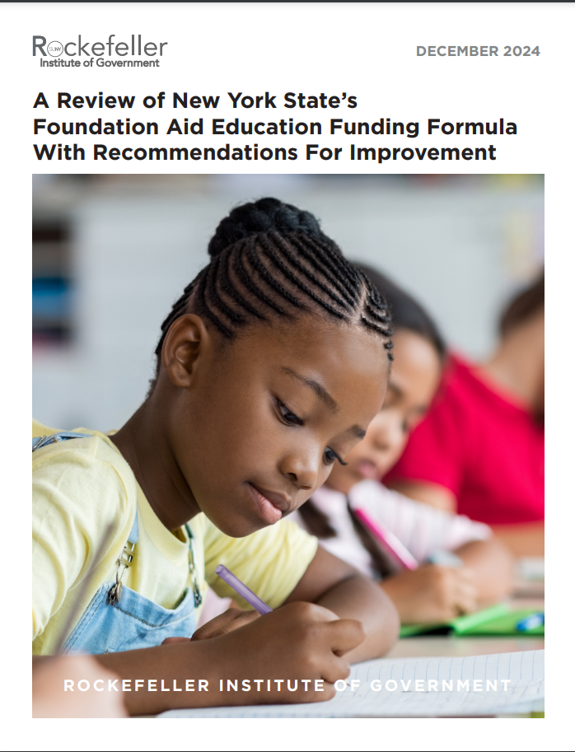
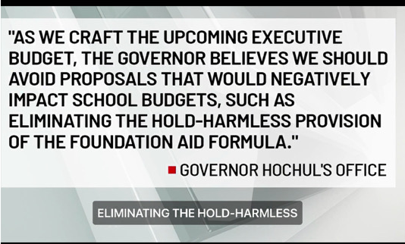
Tuesday, December 3, 2024

Slide 18
Two Questions
How will this affect my district?
What should I say to reporters, legislators, and district residents about the report’s recommendations?

Slide 19
A key passage in the report
“…[M]any of the recommendations in this report are developed and priced-out in isolation from each other. In most cases, each component of the Foundation Aid formula is examined for improvement opportunities on its own, and an impact is measured as if only that element is changed. It is recognized, of course, that elements in the Foundation Aid formula, at the very least, interact with each other and sometimes even may be fully dependent on one another. There also is no way to know which recommendations state policymakers might eventually approve and enact, or how districts may behave after having been given revised options, so there is simply no practical and reliable way to predict the final outcome of the reform proposals or to calculate every permutation of their collective impact.” [Foreword, page 10]

Slide 20
Two Answers
How will this affect my district?
  It depends.
What should I say to reporters, legislators, and district residents about the report’s recommendations?
  The report does not recommend one new or revised Foundation Aid formula. Instead, it recommends steps to update or improve virtually every aspect of the formula.
  Some of the recommendations are sensible—for example, replacing poverty data from the 2000 Census, phasing in changes over time, and using multi-year averages for some items to improve predictability.
  Some of the recommendations could have a negative impact, but that effect might be offset or com-pounded by other recommendations. Others will have a positive effect for at least some districts. Also, some changes would interact, producing a greater positive or negative effect than if implemented alone.
  As the report explains, it’s not possible to determine the impact of the recommendations on any district without knowing the combination of recommendations that might be adopted.

Slide 21
Formula Elements and
Rockefeller Recommendations

Slide 22
Foundation Amount
Explanation:
A uniform per pupil amount for all districts ($8,040 for 2024-25).
Arrived at through a “Successful Schools Model”—average general education instructional expenditures of districts deemed to be successful on a collection of 8 state assessments. As an “efficiency filter,” only spending by the lower spending half of districts is considered.
Developed to comply with court requirement to determine the cost of providing a sound basic education.
Adjusted for inflation by annual change in the nationwide CPI (average of 3.1% annually through 2023-24).
Common Criticisms:
SSM has not been updated in over 10 years—and can’t be due to changes in state standards and assessments. We and others have suggested that the measure should be tied to high school completion.
Also, schools have had to take on additional costs since formula was enacted (e.g., mental health services, school security).

Slide 23
Foundation Amount, continued…
Report Recommendations:
Recognizing other research underway, recommends using 3-year average of results on grades 3-8 ELA and math assessments. Use top 50% performing districts as “successful.” Do not apply “efficiency filter.”
Resulting figure is less than current $8,040 per pupil—consider “scaling-up” by 1.06, if other reforms are not adopted.
Would not add new costs in defining the Foundation Amount.
Would use a 5-year average of the Northeast U.S. region CPI as the inflation adjustment.

Slide 24
Pupil Needs Index
Explanation:
Based on four factors:
3-year average % of K-6 Free/Reduced Price Lunch (FRPL) eligible enrollment
2000 Census poverty rate
% of students who are English Language Learners
Sparsity factor (can benefit districts with <25 students per square mile)
Common Criticisms:
Impossible to justify using 24 year-old Census data.
Problems have emerged with using FRPL data.
Weight given to factors should be re-evaluated (e.g., 0.5 for ELLs)
Additional student need factors should be considered—concentration of poverty, homelessness, foster care placements, etc.

Slide 25
Pupil Needs Index, continued…
Report Recommendations:
Replace 2000 Census poverty data with 3-year rolling average % of 5-17 year-olds in poverty in Small Area Income and Poverty Estimates (SAIPE) produced by Census Bureau.
  Apply variable weight to SAIPE factor—higher weight for higher poverty
Replace FRPL-eligibility with “Economically Disadvantaged” which counts students whose families benefit from one of several economic assistance programs.
Apply variable weight to ELL factor tied to grade level, extent of services, and years of services – for example, 0.65 for students with interrupted formal education (SIFE) or entering high school.
No immediate change to Sparsity Factor recommended; does recommend direct state support to assist rural districts and consider making sparsity aid a separate formula.

Slide 26
Regional Cost Index
Explanation:
Divides state into 9 regions
Index values are based on compensation of workers in occupations with credential requirements similar to those of educators.
RCI values range from 1.000 for North Country and Mohawk Valley to 1.425 for New York City/Long Island
Common Criticisms:
Index values have never been updated (using over 17 year-old data)
With only 9 large regions, differences in RCI values may not reflect actual cost differences within the region and can result in steep differences across regions for neighboring districts

Slide 27
Regional Cost Index, continued…
Current RCI Regions & Index Values
Long Island/New York City Nassau New York City Suffolk | 1.425
Hudson Valley Dutchess Orange Putnam Rockland Sullivan Ulster Westchester | 1.314
Capital District Albany Columbia Greene Rensselaer Saratoga Schenectady Warren Washington | 1.124
Southern Tier Broome Chemung Chenango Delaware Schuyler Steuben Tioga Tompkins | 1.045
Mohawk Valley Fulton Herkimer Montgomery Oneida Otsego Schoharie | 1.000
North Country Clinton Essex Franklin Hamilton Jefferson Lewis St. Lawrence | 1.000
Central New York Cayuga Cortland Madison Onondaga Oswego | 1.103
Finger Lakes Genesee Livingston Monroe Ontario Orleans Seneca Wayne Wyoming Yates | 1.141
Western New York Allegany Cattaraugus Chautauqua Erie Niagara | 1.091

Slide 28
Regional Cost Index, continued…
Report Recommendations:
Replace current measure with Comparable Wage Index for Teachers (CWIFT); produced by the National Center for Education Statistics and is updated annually.
CWIFT can be calculated at school district or county level.
Nearly 3/4ths of districts would see RCI increase with this change.
Could phase-in over 5 years.

Slide 29
Expected Local Contribution
Explanation:
Allows district to use most favorable of 3 options:
Expected Tax Rate:
  Based on what district would raise with tax rate equal to 90% of the 3-year statewide average tax rate. Adjusted by an Income Wealth Index; IWI has a floor of .650 and a ceiling of 2.000.
  Used by only 12 districts.
State Sharing Ratio:
  Uses a four-tier calculation to generate a percentage of the Adjusted Foundation Amount* to be received by district.
  Percentage is based on Combined Wealth Ratio—district property wealth and resident adjusted gross income per weighted pupil compared to statewide averages; property and income are each weighted at 50%.
  For both property and income, districts are permitted to use the lesser of either 2021 data or the average of 2021 and 2020 data.
  Used by 611 districts.
$500 Flat Grant Minimum:
  A third option allows districts to receive $500 per pupil, if either of the two above calculations would generate less than that figure. Used by 45 districts.
    * Adjusted Foundation Amount = Foundation Amount X PNI X

Slide 30
Expected Local Contribution, continued…
Common Criticisms:
.650 IWI minimum overstates ability to pay of very poor districts (nearly ½ of districts have an IWI <.650).
When the Foundation Aid formula was enacted, there was no property tax cap – an increase in property wealth could cause a district to lose Foundation Aid but the tax cap might not allow that district to realize offsetting local revenue without seeking and gaining a tax cap over-ride.
There are significant lags in the property wealth and income data.
Report Recommendations:
Remove .650 IWI floor and raise IWI ceiling to 3.000
Calculate income per capita of 5-17 year-olds in district, rather than per public school pupil—latter arguably overstates ability to pay in districts with many nonpublic students
Allow districts to use most favorable of three blends of property and income – current 50%/50%, or 70% property/30% income, or 30% property/70% income
Replace four-tier State Sharing Ratio calculation

Slide 31
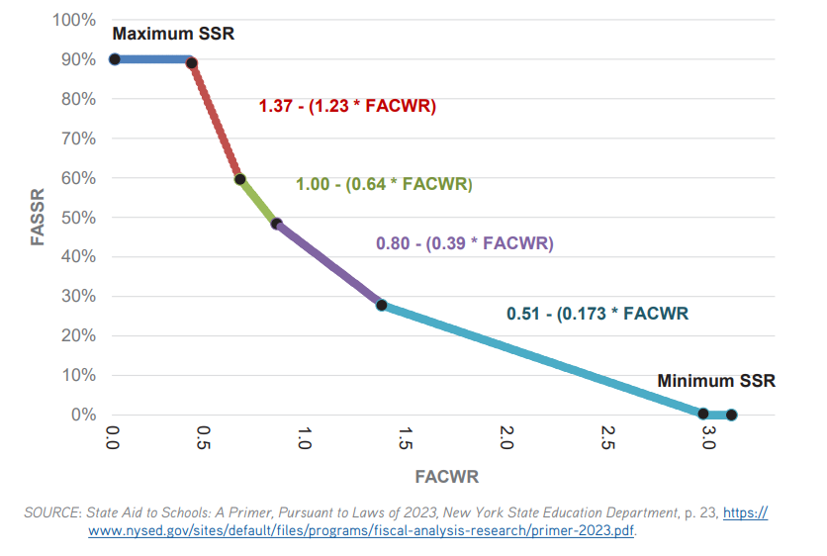
Expected Local Contribution, continued…
Allowing choice of property/income blends should help virtually every district.
Flattening or smoothing slope in State Sharing Ratio could reduce aid for some districts.
Current State Sharing Ratio
Old Operating
Aid Ratio

Slide 32
Selected TAFPU (weighted pupil count)
Explanation:
Based on Average Daily Membership (enrollment), with weightings for students in special education (1.41), declassified from special education (.50), and summer school (.12).
“Selected” refers to fact that districts may use the greater of TAFPU for 2024-25 or the average of 2023-24 and 2024-25 TAFPU—provides some cushioning against declines pupil counts
Common Criticisms:
Reflecting consensus among stakeholders, 2007-08 Regents State Aid Proposal did not propose consolidating into Foundation Aid what was then the largest special education aid formula—consolidation of that special education aid formula into Foundation Aid was proposed by Governor Spitzer and included in the enacted budget.
The uniform 1.41 weighting for all special education students should be replaced by weightings which vary based on level of service—as was the case with the prior formula.

Slide 33
Selected TAFPU (weighted pupil count)
Report Recommendations:
Remove the special education weightings from the Foundation Aid formula; re-establish Public Excess Cost Aid as a separate categorical aid formula.
Replace uniform 1.41 weighting with variable weightings based on extent of special education services.

Slide 34
Save-Harmless Recommendations:
“Once revisions and updates have been made to the Foundation Aid formula:
Establish a per-pupil local income and property wealth threshold above which districts would not be eligible for full Save Harmless aid payments. Similarly, establish an enrollment-loss threshold at which school districts would face reductions in Save Harmless allocations. Reinvest these funds in lower-wealth districts experiencing enrollment growth.
Require districts retaining more than 10 percent of their budget as a year-end balance to apply the excess as an offset to Save Harmless allocations.
Require districts with a 10-year reduction in total student enrollment of 15 percent or more and year-end fund balances of greater than 4 percent to apply the excess balance as an offset against Save Harmless payments.
Enact elements of the Save Harmless modifications proposed in the 2024-25 executive budget, such as a cap on the size of Save Harmless aid reduction any district would face and a progressive local wealth-based schedule that varies the size of such reductions.
Policymakers could establish a three- or five-year ‘phase-out schedule’ for any planned reductions in Save Harmless allocations.”

Slide 35
Other Recommendations:
A general theme in the recommendations is to promote predictability in aid, for example, by phasing in changes and using rolling multi-year averages rather than single year data for some aid factors.
Eliminate set-asides within Foundation Aid
Consider re-establishing a Growth Aid formula to provide current year aid for districts experiencing enrollment growth above a threshold (previously 0.4%).
A plan for shared student mental health services through BOCES
Reserve Funds: “Authorize districts to retain an additional 6 percent (for a total of up to 10 percent) of their annual budgets as an unrestricted year-end balance, subject to a developed and approved plan for spending the additional funds within five years. School districts on Save Harmless would be required to use at least a portion of this year-end balance excess as an offset to their Save Harmless allocation.”
Zero Emission School Buses: “New York should fully underwrite the costs of this state initiative to transition each local school district to an all-electric school bus fleet.”

Slide 36
Regents 2025-26 State Aid Proposal
$2.05 billion total increase, includes $1.67 billion increase in Foundation Aid
Foundation Aid Recommendations:
  First Steps to Formula Changes (+$208.4 million over current law)
    Update the RCI from 2006 to 2024 values; move Westchester County to NYC/Long Island region
    Replace the 2000 Census Poverty measure with recent poverty data
    Replace free- and reduced-price meal data with economically disadvantaged counts
    Eliminate the floor on the income wealth index
  Larger Changes to the Formula
    Research needed on student weights, formula structure, and base starting amount
    Evaluate Rockefeller study for insights
Also recommend increases in funding for CTE, UPK, and special education, and a Growth Aid formula

Slide 37
Some Resources
NYSCOSS Testimony for Rockefeller Institute. August 2024
Historical Data for All Districts Receiving Foundation Aid
“Resurrecting the Promise of Foundation Aid.” New York State Council of School Superintendents. September 2021
“Foundation Aid—What’s Next? Recommendations for Principles and Process.” Educational Conference Board. October 2023”
Two-page summary of formula and issues
“Advocacy: Three Goals for Every Contact,” Councilgram, August 2023

Slide 38
Questions, Ideas?
Contact me at boblowry@nyscoss.org

